Slide 1
Life Organics
Aakash Kamboj
Hemanshu Dharmik
Jatin Rai

Slide 2
AGENDA
Introduction​
Primary goals
​Technologies Used
Functionalities
​Future Scope

Slide 3
Introduction
Life Organics is an e-commerce platform meticulously crafted using cutting-edge technologies, including ASP.NET, HTML, JSON, and SQL. Our commitment to delivering a seamless online shopping experience is reflected in the robust architecture and user-friendly interface of our website.

Slide 4
PRIMARY GOALS
Provide Access to Premium Organic Produce:
Offer a diverse range of high-quality organic fruits and vegetables to customers, ensuring they have easy access to fresh, wholesome, and pesticide-free produce.
Seamless User Experience:
Deliver a user-friendly and intuitive online shopping experience through a well-designed website. The use of ASP.NET, HTML, JSON, and SQL aims to ensure smooth navigation, secure transactions, and a hassle-free customer journey.
Promote Health and Well-being:
Prioritize the health of customers by offering organic products that are free from harmful chemicals and pesticides. Educate and create awareness about the benefits of consuming organic produce for overall well-being.

Slide 5
Technological Innovation:
Leverage modern technologies, such as ASP.NET, HTML, JSON, and SQL, to stay at the forefront of e-commerce excellence. Constantly update and enhance the website to adapt to emerging trends and technological advancements.
Support Sustainable Farming:
Advocate for and support sustainable farming practices by sourcing produce from certified organic farms. Contribute to environmental conservation and promote ethical agricultural methods.

Slide 6
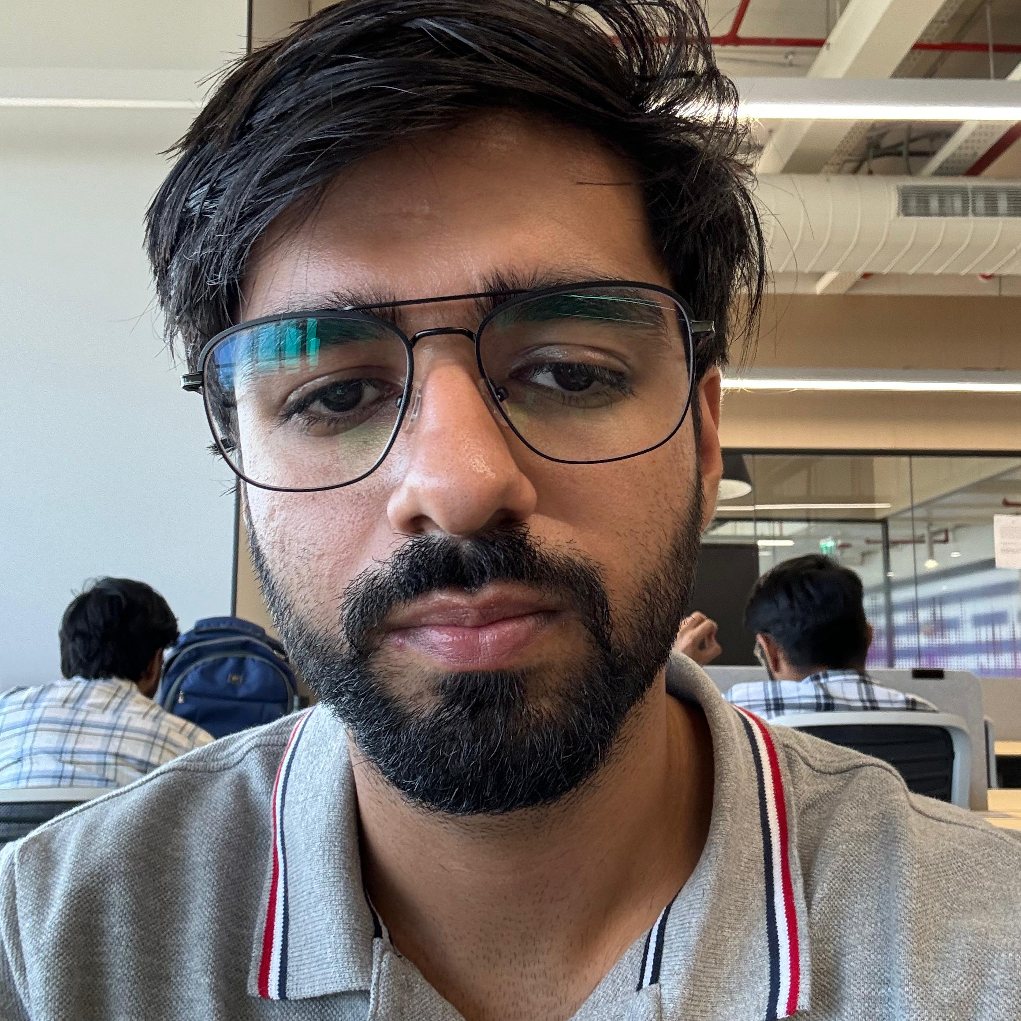


MEET OUR TEAM
Aakash
Hemanshu
Jatin

Slide 7
Technologies used
. ASP.NET (Active Server Pages .NET):
Definition: ASP.NET is a web development framework developed by Microsoft for building dynamic web applications and services.
Key Features:
Server-side scripting for creating dynamic web pages.
Supports a variety of programming languages like C# and VB.NET.
Provides a rich set of tools and libraries for building scalable and robust web applications.
Enables the development of interactive, data-driven websites.

Slide 8
JSON (JavaScript Object Notation):
Definition: JSON is a lightweight data interchange format that is easy for humans to read and write, and easy for machines to parse and generate.
Key Features:
Syntax is based on JavaScript, making it easy for programmers to understand.
Commonly used for data exchange between a server and a web application.
Supports key-value pairs and arrays, providing a flexible and easy-to-parse structure.
Widely adopted for representing structured data in various programming languages.
3. SQL (Structured Query Language):
Definition: SQL is a domain-specific language used for managing and manipulating relational databases.
Key Features:
Allows users to define, query, and manipulate data in relational databases.

Slide 9
Standardized language with variations like MySQL, PostgreSQL, and Microsoft SQL Server.
Common operations include SELECT (querying data), INSERT (adding new data), UPDATE (modifying data), and DELETE (removing data).
Integral for data-driven applications and systems that rely on organized, structured data storage

Slide 10





PLAN FOR PRODUCT LAUNCH
PLANNING
MARKETING
DESIGN
STRATEGY
LAUNCH
Synergize scalable e-commerce
Disseminate standardized metrics
Coordinate e- business applications
Foster holistically superior methodologies
Deploy strategic networks with compelling e- business needs

Slide 11
Future Scope
Mobile Application Development:
Developing a dedicated mobile application for Life Organics can enhance the accessibility for users who prefer shopping on their mobile devices. This move aligns with the increasing trend of mobile commerce and provides a more convenient shopping experience.
Personalized Customer Experience:
Implementing advanced analytics and machine learning algorithms can enable Life Organics to offer personalized recommendations based on customer preferences and purchase history. This can enhance customer satisfaction and increase the likelihood of repeat business.

Slide 12
SUMMARY
In conclusion, Life Organics isn't just a website; it's a commitment to your well-being and a sustainable future. As we've journeyed through the essence of Life Organics – from premium organic produce to cutting-edge technologies powering our platform – it's evident that our mission extends beyond commerce.
Life Organics is about embracing a lifestyle that values health, supports sustainable practices, and connects individuals to the pure goodness of nature. With a seamless online experience crafted with ASP.NET, HTML, JSON, and SQL, we strive to make organic living accessible, enjoyable, and rewarding.
As we step into the future, envision a Life Organics that transcends boundaries, resonates globally, and continually evolves with technology and customer expectations. Your trust in us fuels our commitment to excellence, and together, we're cultivating a community that values not just what's on the plate but the impact it has on the planet and our lives.
Thank you for joining us on this organic odyssey. Life Organics - Nourishing Lives Through Nature. Your journey to wellness starts here.

Slide 13
THANK YOU

